Slide 1


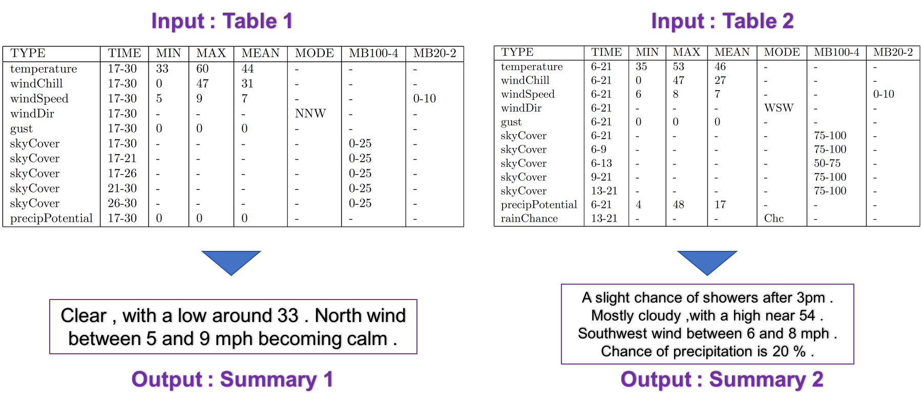
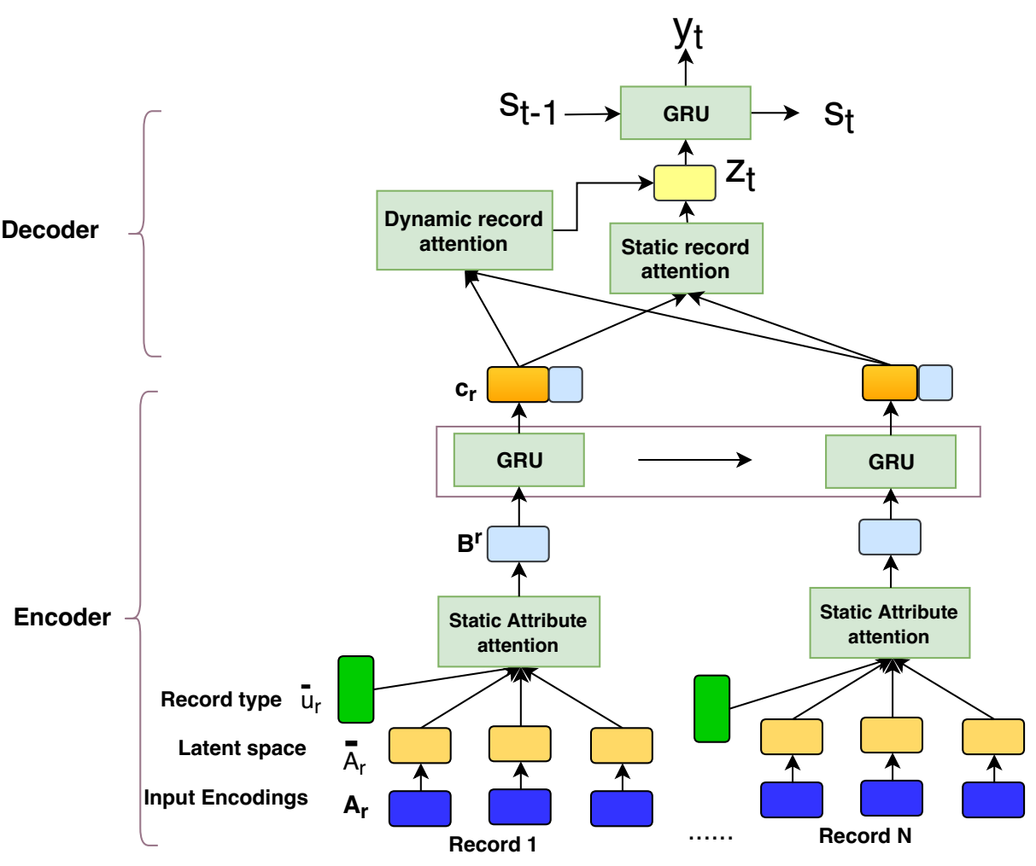

A Mixed Hierarchical Attention based Encoder-Decoder Approach for Standard Table Summarization
NAACL
Parag Jain¹, Anirban Laha¹, Karthik Sankaranarayanany¹, Preksha Nema², Mitesh M. Khapra², Shreyas Shetty²
2018
{pajain34,anirlaha,kartsank}@in.ibm.com {preksha,miteshk,shshett}@cse.iitm.ac.in
¹IBM Research, India
²Indian Institute Of Technology, Madras
Overview
Background: In most practical applications such as finance, healthcare or weather report, data is stored in a form of a table with known schema. Summarizing such data instances into natural language is an important problem.
Objective: Generate abstractive summaries of tables conforming to a predefined fixed schema.
Results: Our experiments on the publicly available WEATHERGOV dataset show around 18 BLEU (∼ 30%) improvement over the current state-of-the-art.
Background and Motivation
Mixed Hierarchical Attention Model
Example:
Summary:
Structured data summarization involves generation of natural language summaries from structured input data.
Tabular data summarization is challenging as the schema or structure can vary across tables.
We formulate the standard table summarization problem, where the tables conform to a fixed schema.
We propose a novel mixed hierarchical attention based approach suitable for tabular inputs arising from a fixed schema.
Some relevant structured data summarization task:
Summarizing Wikipedia infobox, restricted to biography domain – Lebret et al., 2016
Summarizing source code using a neural attention model – Iyer et al., 2016
Generating natural language descriptions from Ontologies - Androutsopoulos et al., 2014; Colin et al., 2016
Challenges in data-to-document generation - Wiseman et al., 2017
Architecture:
Incorporates static attention and dynamic attention at two different levels of the encoder.
Record level: The attention over record representations is dynamic and changes with each decoder time step.
Attribute level: Since the schema is fixed, static attention is used.
Complexity: O(TM + TT') compared to fully dynamic attention at both level O(TMT’). T is the number of records, M is the number of attributes and T' is the number of decoder steps.
Dataset & Results
Example summaries
WeatherGov dataset: 25000:3528:1000 train:dev:test instances, unused soft alignments present in the dataset
Converted the dataset in the form of tables
Model | sBleu | cBleu | Rouge-L
KL | 36.54 | - | -
AKL | 38.40 | 51.50 | -
MBW | 61.0 | 70.4 | -
NHM | 76.2 | 85.0 | 86.4
MHAM | 79.3 | 87.0 | 88.5
KL: Konstas and Lapata, 2013
AKL: Angeli et al., 2010
MBW: Mei et al., 2016
NHM: Non hierarchical version
MHAM: Mixed hierarchical attention model
Reference: Rain and snow likely , becoming all snow after 8pm . Cloudy , with a low around 22 . South southwest wind around 15 mph . Chance of precipitation is 60% . New snow accumulation of less than one inch possible .
NHM : Rain or freezing rain likely before 8pm , then snow after 11pm , snow showers and sleet likely before 8pm , then a chance of rain or freezing rain after 3am . Mostly cloudy , with a low around 27 . South southeast wind between 15 and 17 mph . Chance of precipitation is 80% . Little or no ice accumulation expected . Little or no snow accumulation expected .
MHAM: Snow , and freezing rain , snow after 9pm . Cloudy , with a steady temperature around 23 . Breezy , with a south wind between 15 and 20 mph . Chance of precipitation is 60% . New snow accumulation of around an inch possible .

